Slide 1
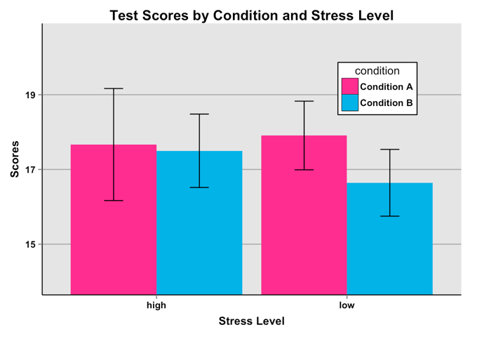
Short-term effects of Yoga on Test Performance By: Devinne Fagen & Hillary Coy
Introduction
Yoga is a form of mind-body medicine that utilizes physical postures and breathing techniques to find complete relaxation (Newham, Wittkowski, Hurley, Aplin, & Westwood, 2014).
Previous research has examined how participation in yoga over a couple months can help reduce perceived stress as well as increase perceived quality of life (Gard, Brach, Holzel, Noggle, Conboy & Lazar, 2012).
PTSD Symptoms: Staples, et al. found in their results that the veterans who participated in yoga experienced significant improvement in the area of hyperarousal and quality of sleep (Staples, Hamilton, & Uddo, 2013).
Workplace Symptoms: Hartfiel, Burton, Rycroft-Malone, Clarke, Havenhand, Khalsa, and Edwards (2012) found in their results that a comparison of a post-questionnaire to a pre-yoga questionnaire indicated that the yoga group experienced less perceived stress, back pain, hostility and sadness. The participants also experienced a higher level of psychological well-being, attentiveness, serenity, and self-assuredness (Hartfiel et al., 2012).
Maternal Anxiety and Stress: Newham et. al. (2014) results identified a significant reduction in stress scores for the yoga group when compared to a treatment-as-usual control group. They also found a significant decrease in cortisol levels and measures of maternal anxiety for the yoga group (Newham et al., 2014).
Based on the studies described above, one may conclude that over time yoga reduces stress and alleviates some physical ailments. In contrast, what are the short-term effects of yoga?
Methods
Subjects: 42 subjects recruited through Eastern Oregon University (EOU) and community members through Facebook.
Materials: The stimuli presented in this experiment were all in the form of YouTube videos. All the stimuli for the informed consent, instruction, math test, and debriefing were presented in the Experimental YouTube video. Hatha yoga was performed by a YouTube video, and the nature video was viewed through YouTube. Materials used to complete math test and answer additional questions included paper and writing utensils.
Design: Between-subjects quasi-experiment. Participants were pseudo-randomly assigned to participate in either Condition A or Condition B based on the last digit of the time on their computer clock:
Even numbers (Condition A): Hatha Yoga video
Odd numbers (Condition B): Relaxed Nature video.
Procedure: In the Experimental YouTube video consent was presented and then participants were asked to pause the video and grab a piece of paper and writing utensil and indicate:
a) their level of stress at the present moment
b) whether they participate in yoga on a regular basis.
Then they were asked to number the paper from 1-25. Participants were presented with instructions on how they would be assigned to conditions. After watching either the Condition A video or Condition B video, participants were given instructions on how to complete a 25 problem timed math test that took 125 seconds to complete. At the end of the test, answers were presented to the math questions and participants were asked to pause the video and grade their answers. They were then instructed to email:
Test Answers
Assigned condition
Whether or not they participate in yoga on a regular basis
If any loading problems with the videos occurred
If Condition A participants actually did participate with the yoga video
Gender
College attendance
Email address
Results
We ran an ANOVA test to see if there was any significant difference between test scores and condition (A vs B) F (1, 38) = .627, p = .434, test scores and stress levels (low vs. high) F (1, 38) = .083, p = .774, or test scores within conditions based on stress levels F(1, 38) = .254, p = .617. We found no significance in any of these categories.
Abstract
This study seeks to examine the immediate effects of yoga on stress and test performance.
In the present study we used a form of yoga called Hatha Yoga.
This study had a control group and a yoga group of participants who engaged in 5 minute video sessions followed by a timed math test.
In light of the results of previous studies, we expected the participants of the yoga condition to have a higher percentage of correct answers on the timed math test than the control group due to reduced stress and a higher level of attention following the yoga session.
We hypothesized that after a single session of yoga, test performance scores would be better for subjects who participated in a yoga video compared to a control group.
The results showed no significance between test scores and within conditions F (1, 38) = .627, p = .434, between test scores and stress levels F (1, 38) = .083, p = .774, or between test scores within conditions based on stress levels F(1, 38) = .254, p = .617.
Discussion/Summary
Although we did not find yoga as having a significant short-term effect on test performance, we believe the topic merits further research. Our study was small and the yoga session was rudimentary and short. There were several variables that were out of the experimenters’ control due to the experiment being performed online. However, under more ideal conditions, if a connection were to be found between yoga and test performance, these findings could be useful in developing study techniques for students. We found no significant short-term effect of participating in yoga on test performance when measured against a control group watching a nature video.
References
*Gard, T., Brach, N., Holzel, B. K., Noggle, J. J., Conboy, L. A., & Lazar, S. W. (2012). Effects of a yoga-based intervention for young adults on quality of life and perceived stress: The potential mediating roles of mindfulness and self-compassion. The Journal of Positive Psychology, 7(3), 165-175. doi:10.1080/17439760.2012.667144
*Hartfiel, N., Burton, C., Rycroft-Malone, J., Clarke, G., Havenhand, J., Khaisa, S. B., & Edwards, R. T. (2012). Yoga for reducing perceived stress and back pain at work. Occupational Medicine, 62, 606-612. doi:10.1093/occmed/kqs168
*Newham, J. J., Clin, A. W., Hurley, J., Aplin, J. D., & Westwood, M. (2014). Effects of antenatal yoga on maternal anxiety and depression: A randomized controlled trial. Depression and Anxiety, 31, 631-640. doi:10.1002/da.22268
*Staples, J. K., Hamilton, M. F., & Uddo, M. (2013). A yoga program for the symptoms of post-traumatic stress disorder in veterans. Military Medicine, 178(8), 854-860. doi: 10.7205/MILMED-D-12-00536

Slide 2
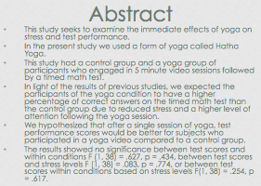

Slide 3
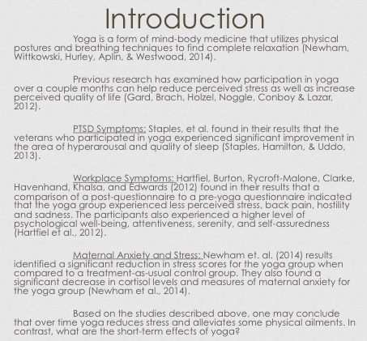

Slide 4
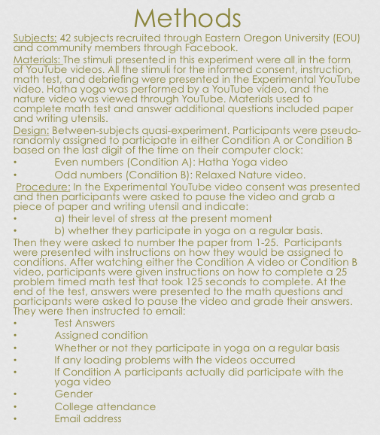

Slide 5
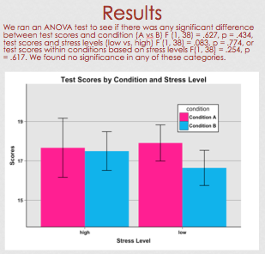

Slide 6
